Slide 1

Python for Engineers
Subject Code: AI102P
Faculty: Dr Vidhi Bishnoi

Slide 2
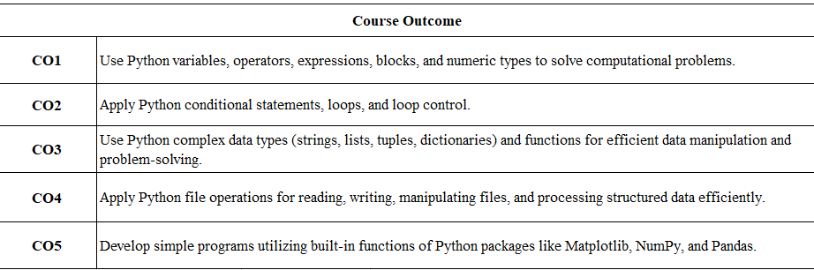
Course Outcomes

Slide 3
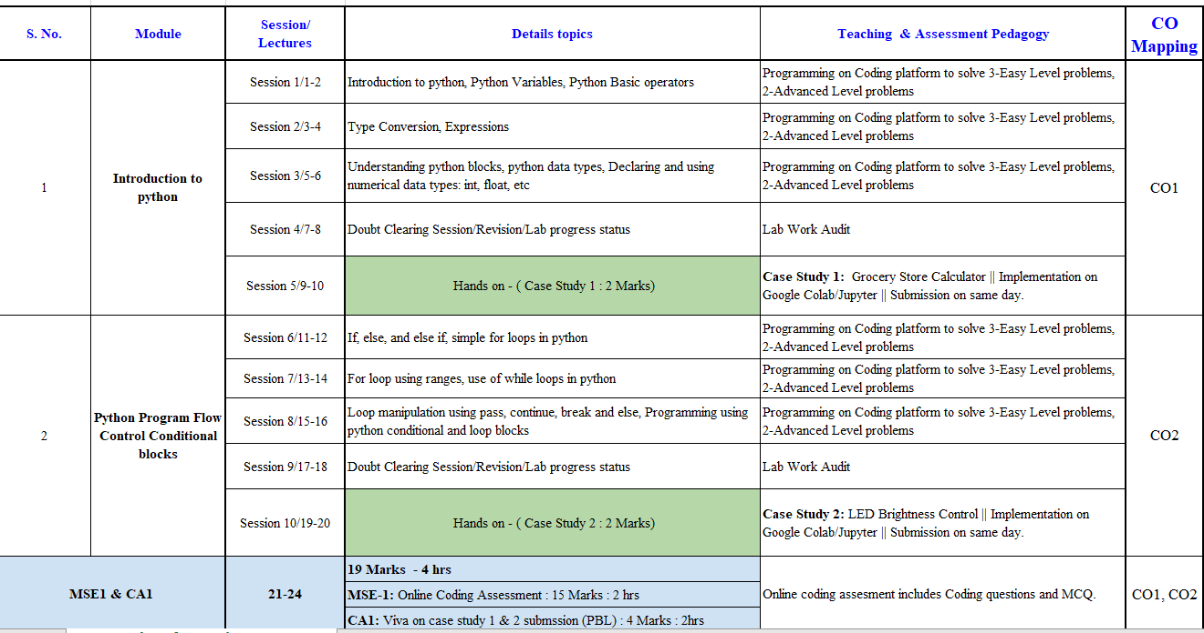
Detailed Syllabus

Slide 4
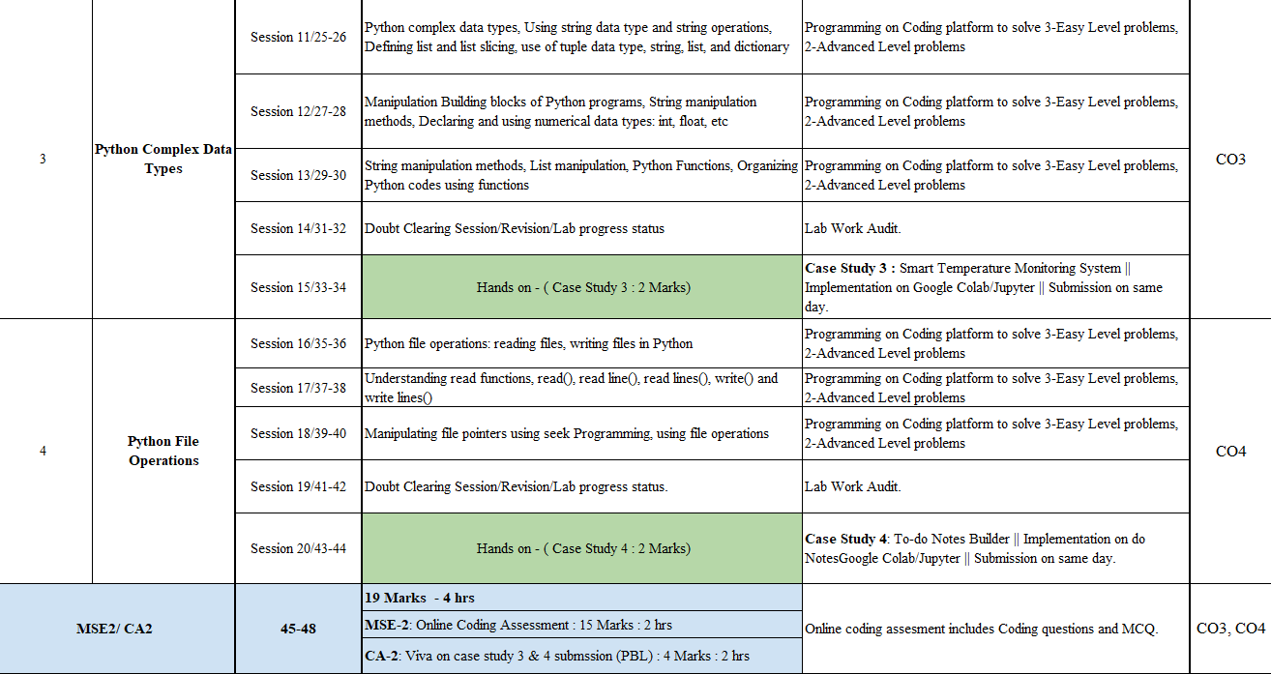

Slide 5
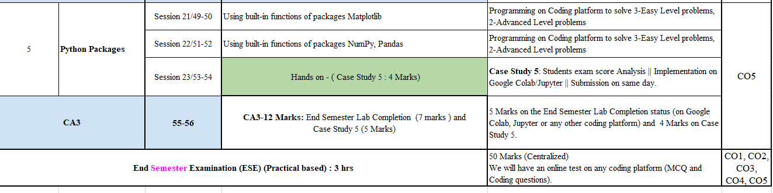

Slide 6
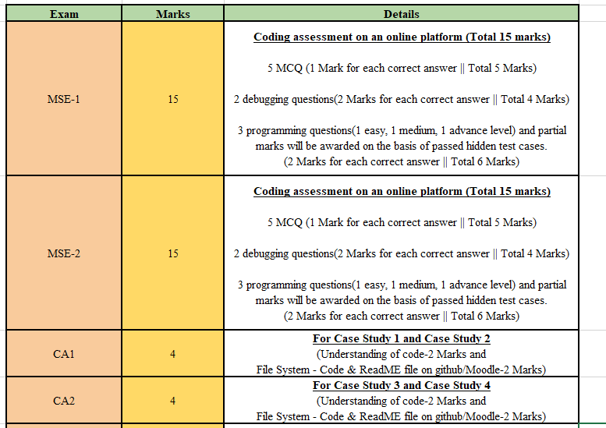
Examination Details

Slide 7
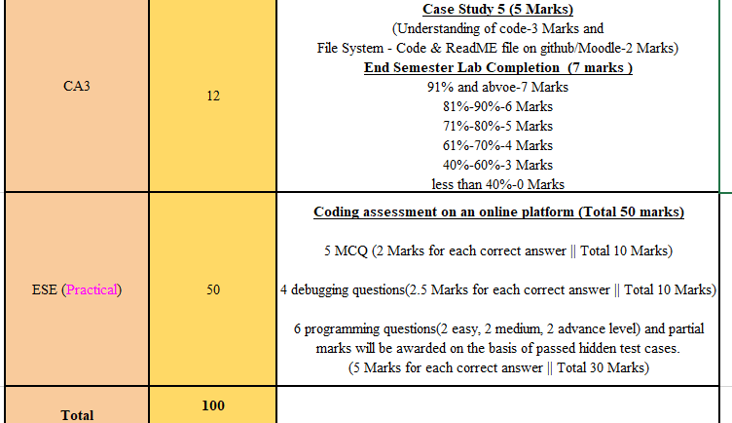

Slide 8
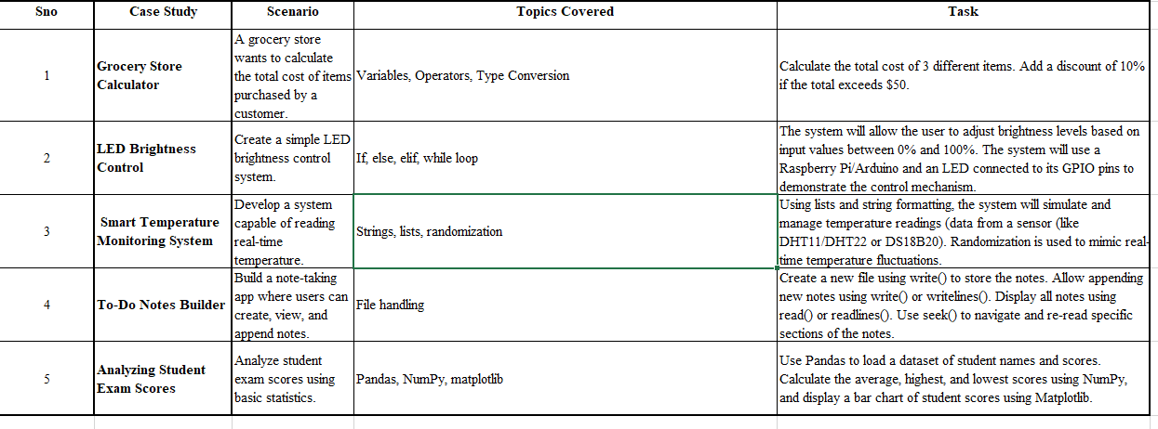
Case Studies

Slide 9
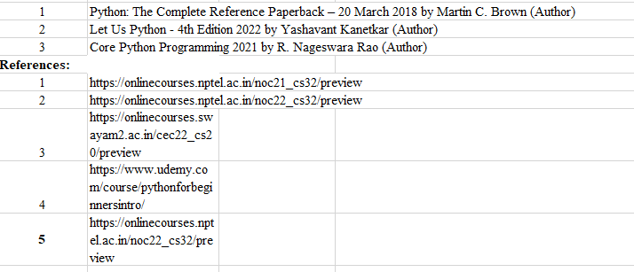
Text Books

Slide 10
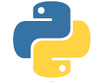
Introduction to Python
Python is an object-oriented, interpreted, high-level programming language. It is general purpose, and we use it to develop GUI and web applications
With Python, we can concentrate on the business logic of our code rather than investing a lot of time in common programming tasks

Slide 11
What is Python?
Python is a popular object-oriented programming language.
It was created by Guido van Rossum, and released in 1991.
The most recent major version of Python is Python 3.12
It uses an interpreter(python shell) & thus is an interpreted language
It is dynamic

Slide 12
Features of Python
Open source & free language
Interpreted language
Rich library of pre-defined functions
Case-sensitive
Portable & Platform Independent
It has syntax that allows developers to write programs with fewer lines than some other programming languages.

Slide 13
Dynamic Typing and Dynamic Memory Allocation
Python variables are dynamically typed, meaning that the type of a variable is determined at runtime.
This flexibility requires Python to store additional metadata with each object to keep track of its type and other information.
This extra overhead increases the memory footprint of Python objects.
For example, in Python, even simple variables like integers or strings carry additional metadata (e.g., type information) which isn't present in statically typed languages like C or Java.

Slide 14
Applications of Python
It can be used to handle big data and perform complex mathematics.
AI, ML, Data Science, NLP
Web development
Software development

Slide 15
Introduction to Python Variables
Whenever we build any application, we need to be able to store some data in our systems memory. We do that using variables.
Simply put, variables are used to store and retrieve data from our systems memory
We can store value in a variable by either assigning a value to a variable or getting the value as input from user
A variable should start with a letter or an underscore and cannot start with numbers.

Slide 16
Rules for naming Variable/Identifier:
Begins with an upper case/lower case alphabet/_ .It cannot start with a digit
It can be of any length
It should not be a keyword
We cannot use special symbols(!, @, #, $, %, etc)

Slide 17


Python Variables –Assigning Values
There are two ways of assigning values to a variable:

Slide 18
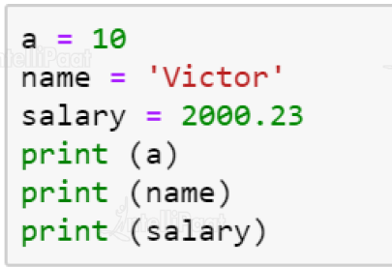
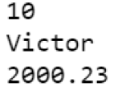
Python Variables –Assigning Values
Assigning a single value to a variable:

Slide 19
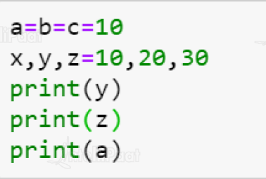
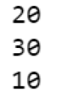
Assigning multiple values:

Slide 20
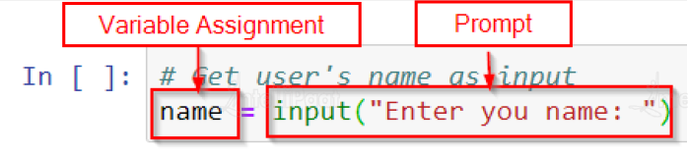
Python Variables –Getting User Input
To get input from user in python and then assign that value to a python variable we need to use the input function
To use the input function we need to also show a prompt to user asking them to enter a value

Slide 21
Q-: Write the corresponding Python assignment statements:
Assign 10 to variable length and 20 to variable breadth.
b) Assign the average of values of variable’s length and breadth to a variable sum
c) Assign the strings ‘Mohandas’, ‘Karamchand’, and ‘Gandhi’ to variables first, middle and last.
P-1 : WAP to Display values of variables in python.
P-2 : Write a Python program to find the area of a rectangle given that its length is 10 units and breadth is 20 units

Slide 22
P1 : message = ‘hello world’
print(message)
userid = 101
print(‘userid is ’, userid)
P2: # To find the area of a rectangle
length = 10
breadth = 20
area = length * breadth
print(area)

Slide 23
Comments
Comments are used to add a remark or a note in the source code.
Comments are not executed by an interpreter.
In Python, a comment starts with # (hash sign).
E.g-1: #Variable amount is the total spending on
#grocery
amount = 3400
E.g-2: #totalMarks is the sum of marks in all the tests
#of Mathematics
totalMarks = test1 + test2 + finalTest

Slide 24
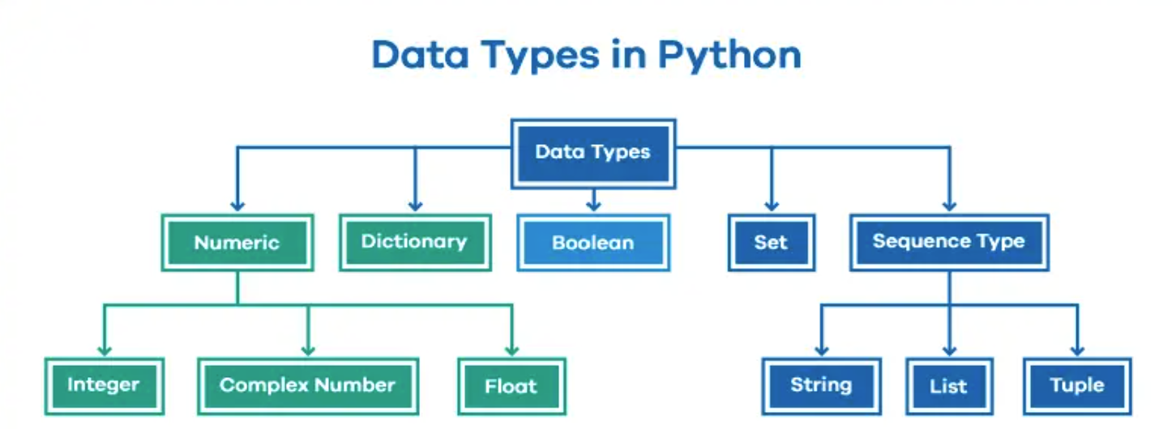
DATA TYPES
Every value belongs to a specific data type in Python.
Data type identifies the type of data values a variable can hold and the operations that can be performed on that data.
Data type of a variable can be known by using function type()

Slide 25
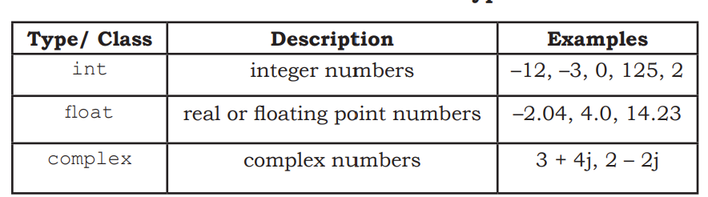
1) Numeric
Number data type stores numerical values only.
Boolean data type (bool) is a subtype of integer.
It is a unique data type, consisting of two constants, True(1) and False(0)

Slide 26
P-3 : WAP to determine the data type of the variable using built-in function type().

Slide 27
P-3: num1 = 10
type(num1)
num2 = -1210
type(num2)
var1 = True
type(var1)
float1 = -1921.9
type(float1)
float2 = -9.8*10**2
print(float2, type(float2))

Slide 28
2) Sequence
A Python sequence is an ordered collection of items, where each item is indexed by an integer.
The three types of sequence data types available in Python are:
Strings
Lists and
Tuples

Slide 29
a) Strings
String is a group of characters.
These characters may be alphabets, digits or special characters including spaces.
String values are enclosed either in single quotation marks (e.g., ‘Hello’) or in double quotation marks (e.g., “Hello”)
str1 = 'Hello Friend’
str2 = "452“
We cannot perform numerical operations on strings, even when the string contains a numeric value, as in str2

Slide 30
b) List
List is a sequence of items separated by commas and the items are enclosed in square brackets [ ].
#To create a list
list1 = [5, 3.4, "New Delhi", "20C", 45]
#print the elements of the list
print(list1)

Slide 31
c) Tuple
Tuple is a sequence of items separated by commas and items are enclosed in parenthesis ( ).
Once created, we cannot change the tuple.
E.g : #create a tuple
tuple1 = (10, 20, "Apple", 3.4, 'a’)
#print the elements of the tuple
print(tuple1)

Slide 32
3) Set
Set is an unordered collection of items separated by commas and the items are enclosed in curly brackets { }.
A set is similar to list, except that it cannot have duplicate entries.
Once created, elements of a set cannot be changed
#create a set
set1 = {10,20,3.14,"New Delhi"}
set2 = {1,2,1,3}
print(type(set1))
print(set1)
Print(set2)

Slide 33
4) None
None is a special data type with a single value.
It is used to signify the absence of value in a situation.
None supports no special operations, and it is neither same as False nor 0 (zero).
myVar = None
print(type(myVar))
print(myVar)

Slide 34
5) Mapping
Mapping is an unordered data type in Python.
Currently, there is only one standard mapping data type in Python called dictionary.
Dictionary in Python holds data items in key-value pairs.
Items in a dictionary are enclosed in curly brackets { }.
Dictionaries permit faster access to data
keys are usually strings and their values can be any data type
#create a dictionary
dict1 = {'Fruit':'Apple', 'Climate':'Cold', 'Price(kg)':120}
print(dict1)
print(dict1['Price(kg)'])

Slide 35
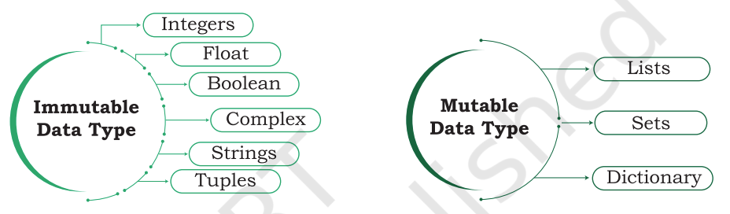
Mutable & Immutable Data Types
Variables whose values can be changed after they are created and assigned are called mutable.
Variables whose values cannot be changed after they are created and assigned are called immutable.
When an attempt is made to update the value of an immutable variable, the old variable is destroyed and a new variable is created by the same name in memory.

Slide 36
Q: Which data type will be used to represent the following data values and why?
Number of months in a year
b) Resident of Delhi or not
c) Mobile number
d) Pocket money
e) Volume of a sphere
f) Perimeter of a square
g) Name of the student
h) Address of the student

Slide 37
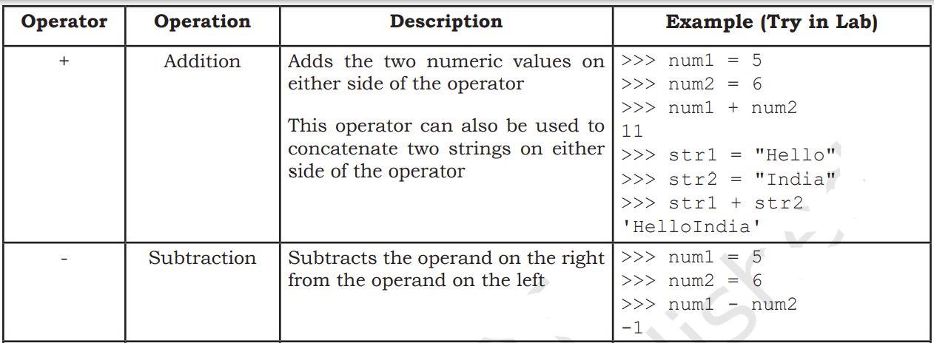
OPERATORS
An operator is used to perform specific mathematical or logical operation on values
1) Arithmetic Operators :

Slide 38
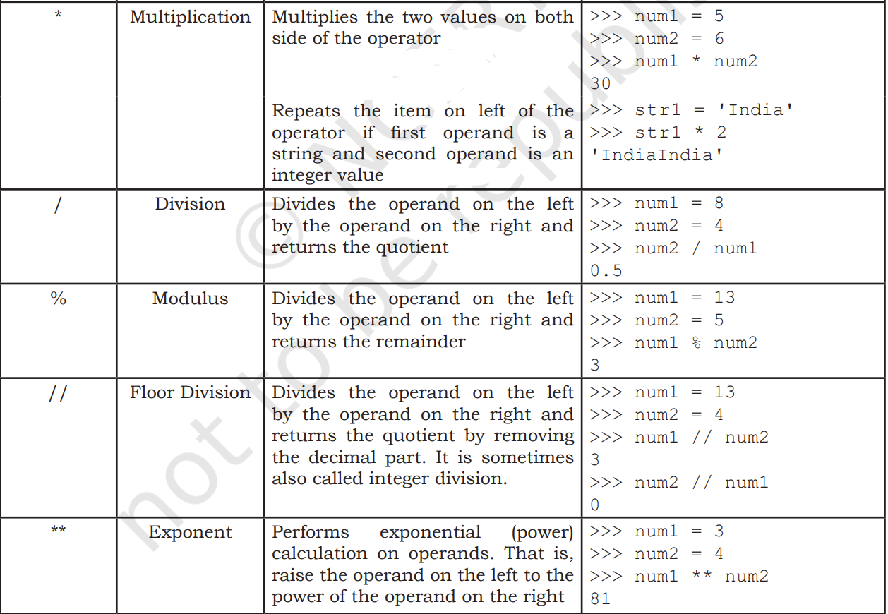

Slide 39
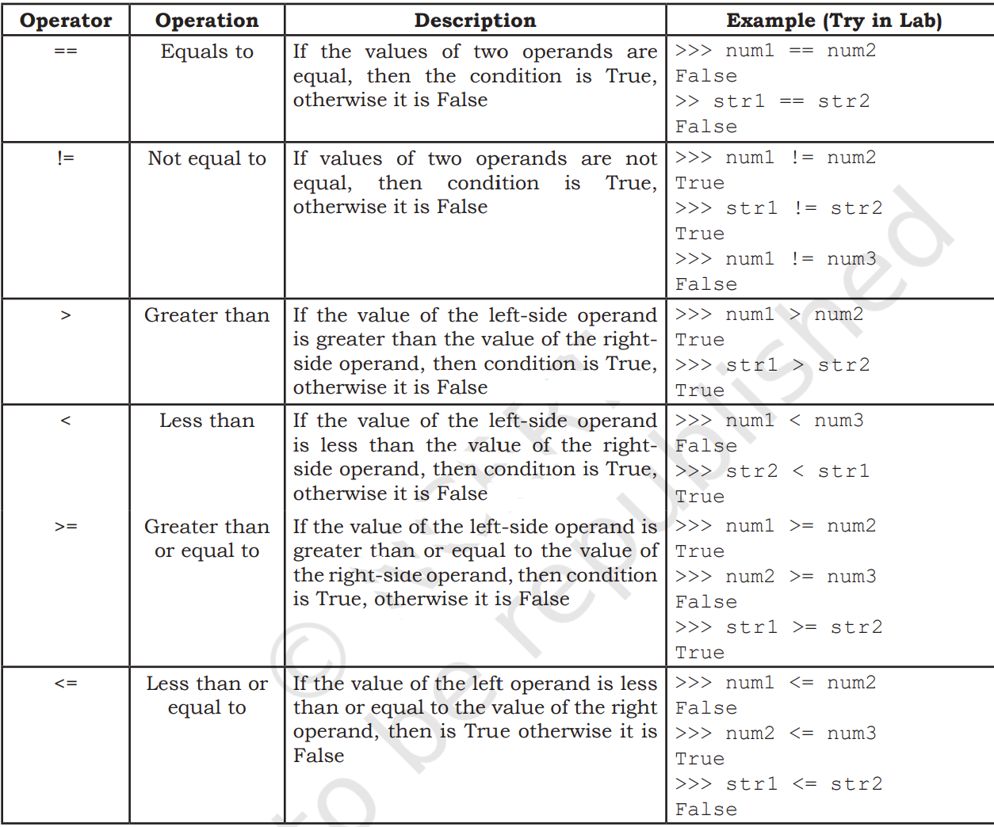
2) Relational Operators compares the values of the operands on its either side and determines the relationship among them.
Assume the Python variables num1 = 10, num2 = 0, num3 = 10, str1 = "Good", str2 = "Afternoon" for the following egs :

Slide 40
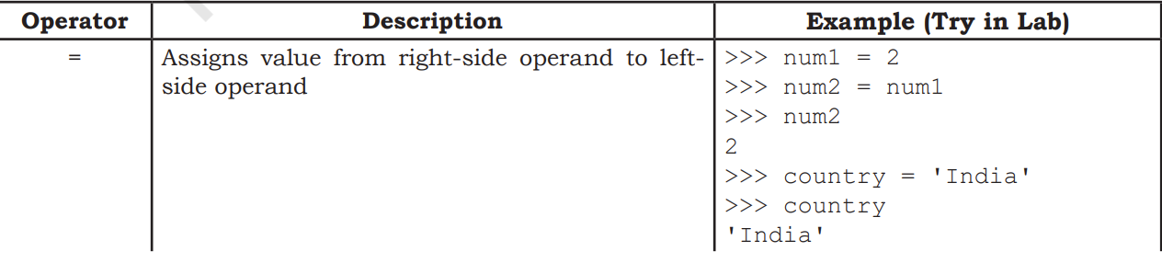
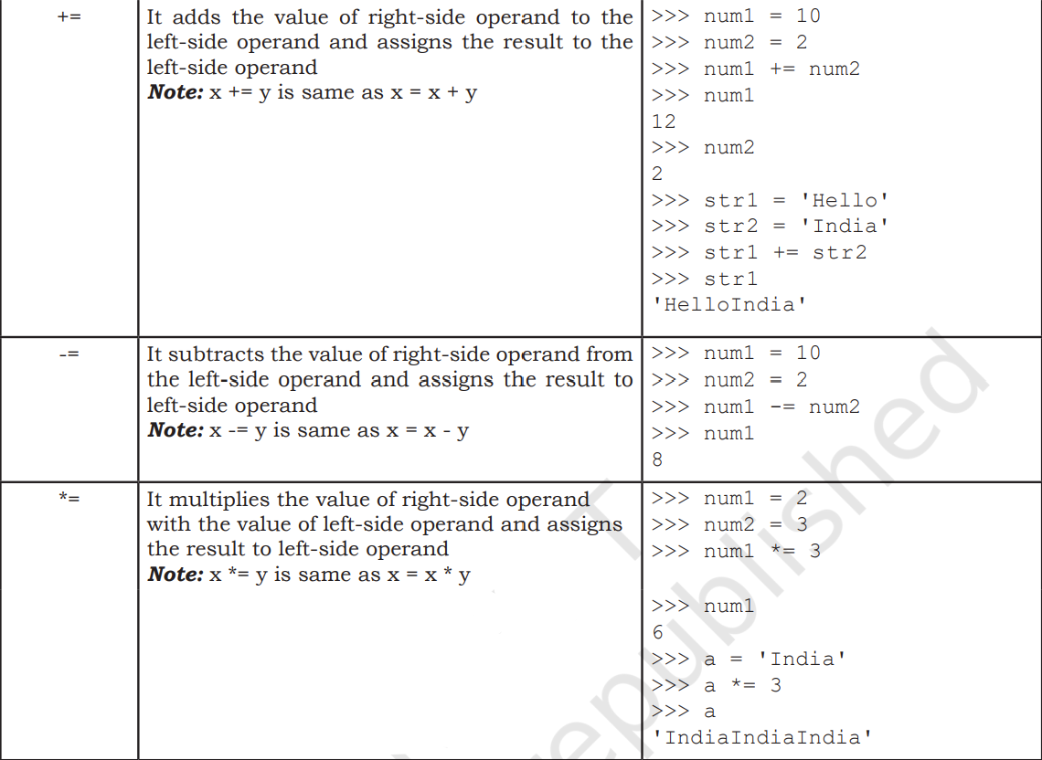
3) Assignment Operators

Slide 41
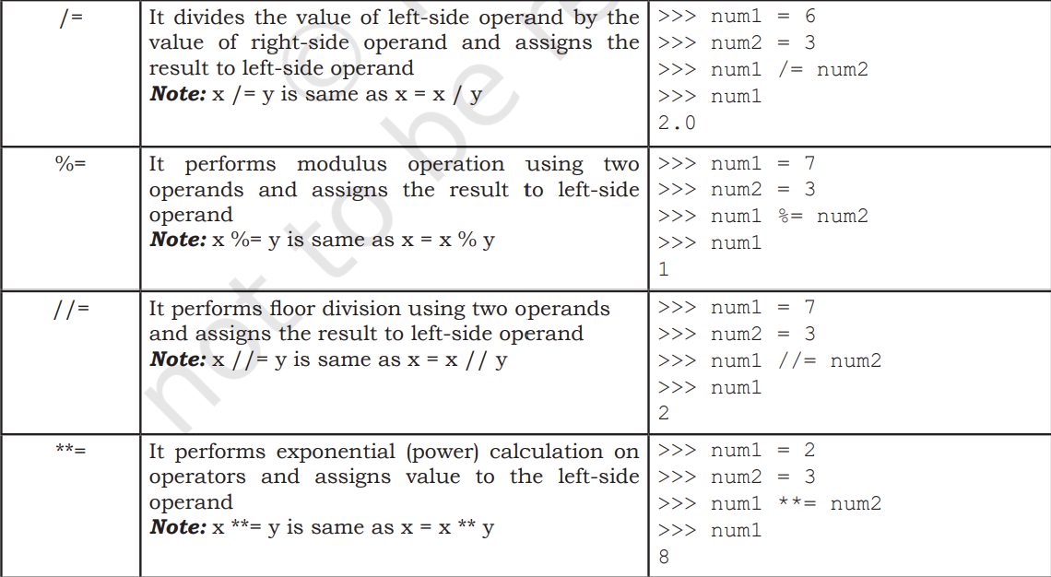

Slide 42
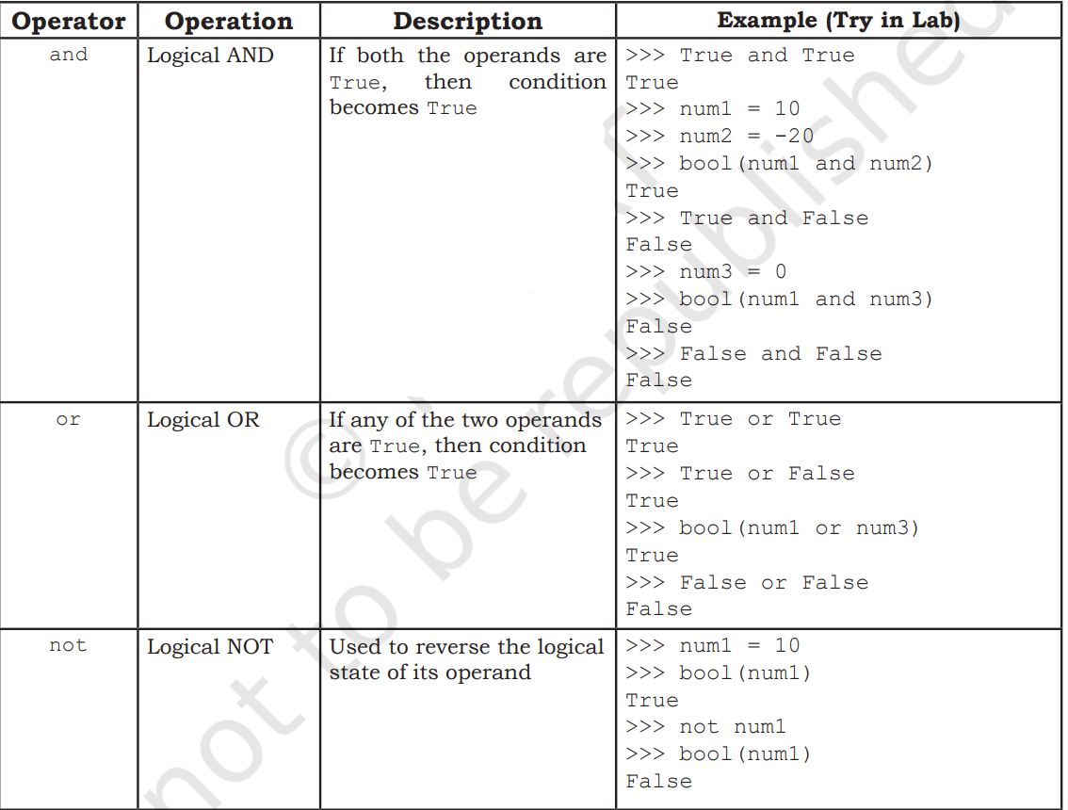
4) Logical Operators There are three logical operators supported by Python.
These operators (and, or, not) are to be written in lower case only.

Slide 43
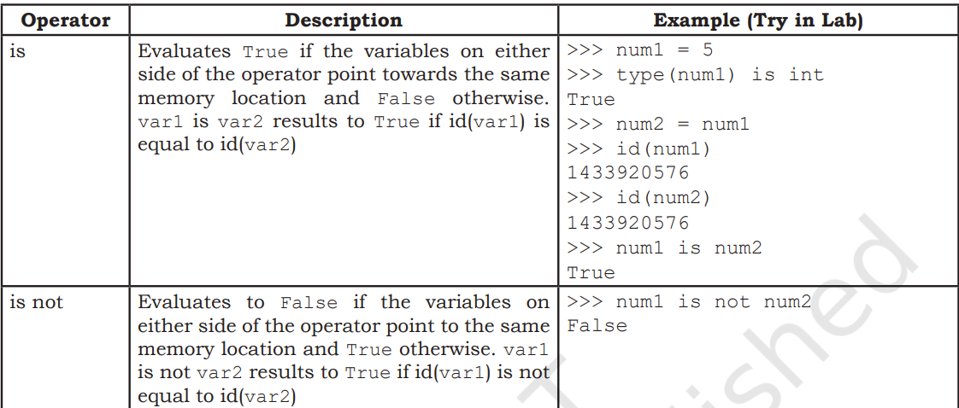
5) Identity Operators
Identity operators are used to determine whether the value of a variable is of a certain type or not.
Identity operators can also be used to determine whether two variables are referring to the same object or not.
There are two identity operators.

Slide 44
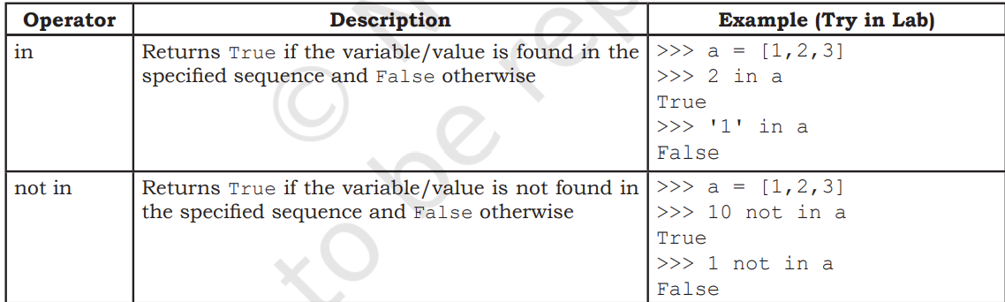
6) Membership Operators
Membership operators are used to check if a value is a member of the given sequence or not.

Slide 45
Q1 : Write logical expressions corresponding to the following statements in Python and evaluate the expressions (assuming variables num1, num2, num3, first, middle, last are already having meaningful values):
The sum of 20 and –10 is less than 12.
b) num3 is not more than 24
c) 6.75 is between the values of integers num1 and num2.
d) The string ‘middle’ is larger than the string ‘first’ and smaller than the string ‘last’.
e) List Stationery is empty.
Q2: Add a pair of parentheses to each expression so that it evaluates to True.
0 == 1 == 2
2 + 3 == 4 + 5 == 7
1 < -1 == 3 > 4

Slide 46
Q3 : Write the output of the following:
num1 = 4
num2 = num1 + 1
num1 = 2
print (num1, num2)
b) num1, num2 = 2, 6
num1, num2 = num2, num1 + 2
print (num1, num2)
c) num1, num2 = 2, 3
num3, num2 = num1, num3 + 1
print (num1, num2, num3)

Slide 47
EXPRESSIONS
An expression is defined as a combination of constants, variables, and operators.
A value or a standalone variable is also considered as an expression but a standalone operator is not an expression.
Some examples of valid expressions are given below :
100
(ii) 3.0 + 3.14
(iii) num
(iv) 23/3 -5 * 7(14 -2)
(v) num – 20.4
(vi) "Global" + "Citizen"

Slide 48
Precedence of Operators
When an expression contains different kinds of operators, precedence determines which operator should be applied first.
The higher precedence operator is evaluated before the lower precedence operator (PEMDAS: Parentheses, Exponents, Multiplication and Division, and Addition and Subtraction.)
Parenthesis can be used to override the precedence of operators.
For operators with equal precedence, the expression is evaluated based on its associativity i.e., left associative (left to right) and right associativity (right to left).
The associativity of assignment operators is right to left.
The associativity of arithmetic and relational operators are left to right.

Slide 49
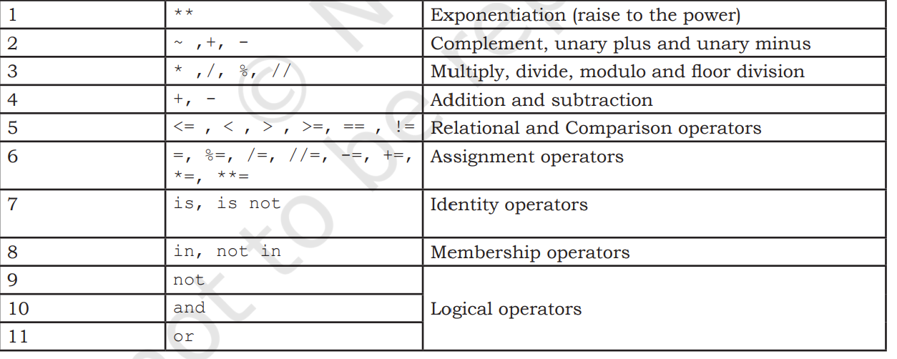
Precedence of Operators

Slide 50
Q : How will Python evaluate the following expression?
20 + 30 * 40
20 - 30 + 40
(20 + 30) * 40
15.0 / 4 + (8 + 3.0)

Slide 51
STATEMENT
In Python, a statement is a unit of code that the Python interpreter can execute.
E.g : x = 4
cube = x ** 3
print (x, cube)

Slide 52
INPUT & OUTPUT
In Python, we have the input() function for taking the user input.
It accepts all user input as string.
The user may enter a number or a string but the input() function treats them as strings only.
The syntax for input() is:
input ([Prompt])
Prompt is the string we may like to display on the screen prior to taking the input, and it is optional.

Slide 53
Example
fname = input("Enter your first name: ")
age = input("Enter your age: ")
Enter your age: 19
type(age)
#function int() to convert string to integer
age = int( input("Enter your age:"))
type(age)

Slide 54
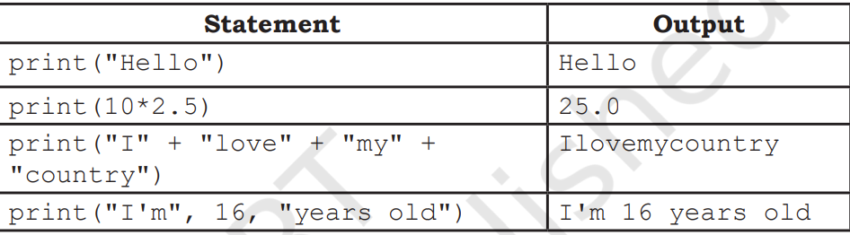
Python uses the print() function to output data to standard output device — the screen
The syntax for print() is:
print(value [, ..., sep = ' ', end = '\n’])
sep: The optional parameter sep is a separator between the output values. We can use a character, integer or a string as a separator. The default separator is space.
• end: This is also optional and it allows us to specify any string to be appended after the last value. The default is a new line

Slide 55
TYPE CONVERSION
Consider the following program
num1 = input("Enter a number and I'll double it: ")
num1 = num1 * 2
print(num1)
Output :
Enter a number and I'll double it: 2
22

Slide 56
Example-2
num1 = input("Enter a number and I'll double it: ")
num1 = int(num1)
#convert string input to #integer
num1 = num1 * 2
print(num1)
Now, the program will display the expected output as follows:
Enter a number and I'll double it: 2
4

Slide 57
Data type conversion can happen in two ways:
Explicitly (forced) when the programmer specifies for the interpreter to convert a data type to another type; or
Implicitly, when the interpreter understands such a need by itself and does the type conversion automatically.
Explicit Conversion :
also called type casting happens when data type conversion takes place because the programmer forced it in the program.
The general form of an explicit data type conversion is:
(new_data_type) (expression)

Slide 58
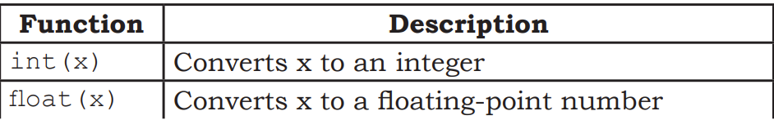
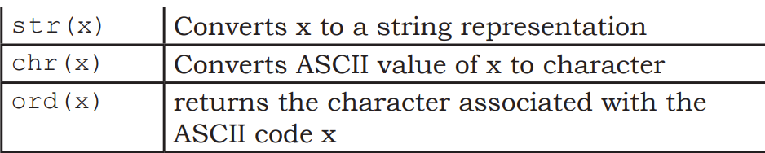
Following are some of the functions in Python that are used for explicitly converting an expression or a variable to a different type :
Q: Write a Program of explicit type conversion from int to float.

Slide 59
Sol : num1 = 10
num2 = 20
num3 = num1 + num2
print(num3)
print(type(num3))
num4 = float(num1 + num2)
print(num4) print(type(num4))

Slide 60
b) Implicit conversion, also known as coercion, happens when data type conversion is done automatically by Python .
Program to show implicit conversion from int to float.
#Implicit type conversion from int to float
num1 = 10 #num1 is an integer
num2 = 20.0 #num2 is a float
sum1 = num1 + num2 #sum1 is sum of a float and an integer
print(sum1)
print(type(sum1))

Slide 61
Q: Give the output of the following when num1 = 4, num2 = 3, num3 = 2
a) num1 += num2 + num3
print (num1)
b) num1 = num1 ** (num2 + num3)
print (num1)
c) num1 **= num2 + num3
d) num1 = '5' + '5’
print(num1)

